Slide 1
CHALLENGE #0: STEM CELLS
Aman Dalmia Athavan Thambimuthu

Slide 2
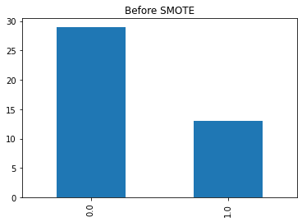
Dataset
Size
42 samples
102 Features
Feature Description
Continuous Dataset with Different Ranges
Target Variable(y)
>90% -> (sufficient)
<90% -> (insufficient)
Imbalanced DataSet
29 insufficient samples
13 sufficient samples

Slide 3
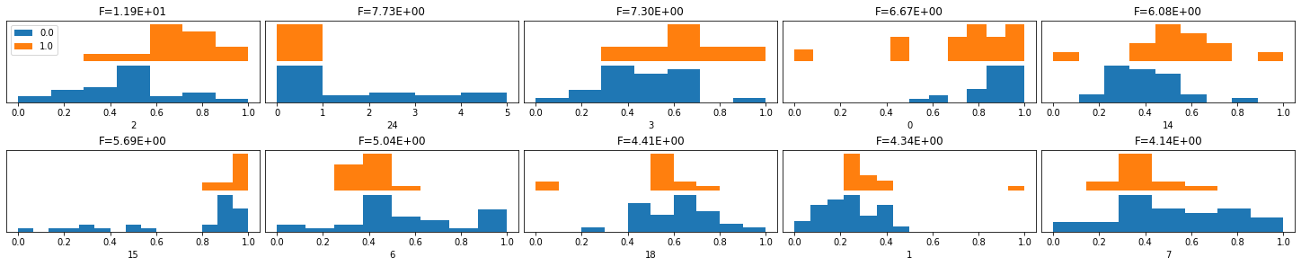
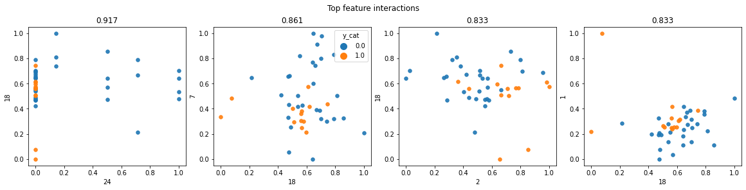
Exploratory Data Analysis

Slide 4
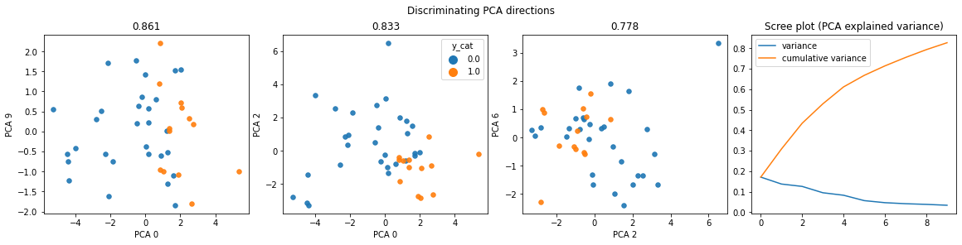
Exploratory Data Analysis

Slide 5
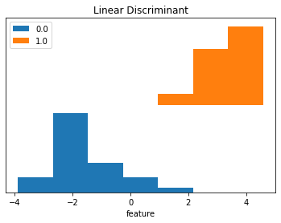
Linear Discriminant

Slide 6
Preprocessing
Hot-Encoded the y value
Normalization done by Min-Max Scalar

Slide 7
Feature Selection
Employed 4 feature selection techniques:
Pearson Correlation
Chi-Squared Test
Recursive Feature Elimination
Lasso (L1) Regularization
Implemented 2 strategies for selecting features:
Union (combined features from all methods):
63 features
Intersection (features recognized by all methods):
31 features
Future work:
Rigorously compare both strategies
Determine most effective feature selection for hackathon project

Slide 8
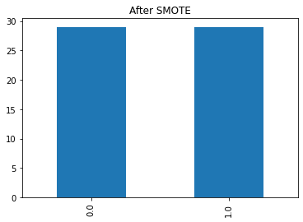
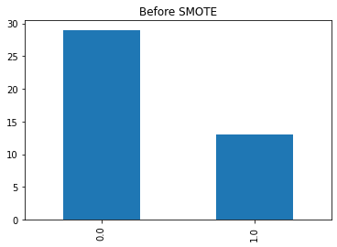
SMOTE Technique
Class imbalance in dataset
29 under threshold
13 over threshold
SMOTE
Prevents majority class bias
Generates synthetic samples
Balances classes

Slide 9
Models Investigated
Explored basic ML models:
Logistic Regression, SVC, GaussianNB, MultinomialNB
SGDClassifier, KNeighborsClassifier, DecisionTreeClassifier
Ensemble methods: RandomForest, GradientBoosting, XGBClassifier
Implemented Cross Validation:
Leave One Out Approach
MonteCarlo
Identify Best Model During Training

Slide 10
Results with SMOTE and Feature Selection
 | Accuracy | MCC
SMOTE + 63 features | 0.89 | 0.72
Without SMOTE + 63 features | 0.94 | 0.8
Without SMOTE + 31 Features | 0.85 | 0.72
SMOTE + 31 Features | 0.81 | 0.66
Compared 2 feature selection strategies:
63 features (union): notable results
31 features (intersection): inferior performance
Compared 63-feature selection with/without SMOTE

Slide 11
Model Results with LeaveOneOut
Model Name | Precision | Recall | MCC | Accuracy
Logistic Regression | 0.385 | 1.0 | 0.385 | 0.556
SVC | 0.4 | 0.8 | 0.305 | 0.611
GaussianNB | 0.294 | 1.0 | 0.15 | 0.333
Multinomial NB | 0.4 | 0.4 | 0.169 | 0.667
SGDClassifier | 0.417 | 1.0 | 0.439 | 0.611
KNeighborsClassifier | 0.273 | 0.6 | -0.014 | 0.444
DecisionTreeClassifier | 0.571 | 0.8 | 0.523 | 0.778
RandomForestClassifier | 0.833 | 1.0 | 0.877 | 0.944
GradientBoostingClassifier | 0.429 | 0.6 | 0.269 | 0.667
XGBClassifier | 0.833 | 1.0 | 0.877 | 0.944
AdaBoost | 0.75 | 0.6 | 0.564 | 0.833

Slide 12
Model Results with MonteCarlo
Model Name | Precision | Recall | MCC | Accuracy
Logistic Regression | 0.417 | 1.0 | 0.439 | 0.611
SVC | 0.444 | 0.8 | 0.372 | 0.667
GaussianNB | 0.294 | 1.0 | 0.15 | 0.333
Multinomial NB | 0.385 | 1.0 | 0.385 | 0.556
SGDClassifier | 0.417 | 1.0 | 0.439 | 0.611
KNeighborsClassifier | 0.333 | 0.8 | 0.175 | 0.5
DecisionTreeClassifier | 0.385 | 1.0 | 0.385 | 0.556
RandomForestClassifier | 0.75 | 0.6 | 0.564 | 0.833
GradientBoostingClassifier | 0.556 | 1.0 | 0.62 | 0.778
XGBClassifier | 0.714 | 1.0 | 0.777 | 0.889
LightGBM | 0.714 | 1.0 | 0.777 | 0.889
VotingClassifier | 0.571 | 0.8 | 0.523 | 0.778

Slide 13
Conclusion
31-feature strategy outperformed 63-feature approach
Best performance: XGBClassifier model
Precision: 0.83
Recall: 1.0
MCC: 0.877
Accuracy: 94.4%
SMOTE implementation:
Decreased accuracy

